Slide 1
Vaccinations vs Influenza
team 5: analyticus

Slide 2
Team and Agenda
Team
Xiangyu Zhang
Daniel Ohriner
Yachen Yu
Patrick Humpphries
Agenda
Introduction
The Story Begins
Challenges and Lessons Learned
Geographic Perspective
Graphical Perspective
Questions and Answers

Slide 3
The Story Begins
Problem: During the recent flu season, the effectiveness of the vaccine was questioned.
Hypothesis: If the vaccine was effective, then states with high vaccination rates will have low influenza rates.
Test: Compare vaccination rates from Health and Human Services (HHS) and compare them to the rates of influenza from the Center of Disease Control (CDC)

Slide 4
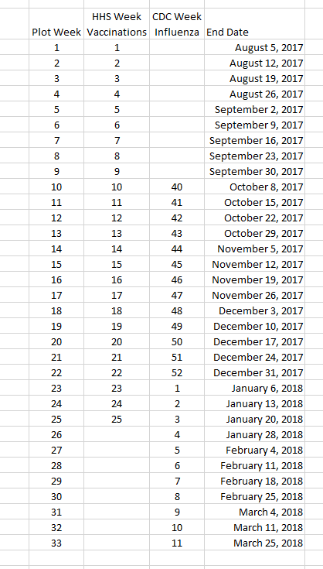
Challenges Data Normalization
CDC Calendar Weeks
HHS Used Flu Season
Normalized on HHS

Slide 5
Lessons Learned
pandas Dataframes facilitates data manipulation.
Government APIs return json objects.
json objects can be loaded directly into pandas Dataframes.
pandas Dataframes can write directly to json files.
json files can be read directly into pandas

Slide 6
Geographic Plot 1 by Xiangyu

Slide 7
Geographic Plot 2 by Xiangyu

Slide 8
Geographic Plot 3 by Xiangyu

Slide 9
Numerical Plot 1 by Sean

Slide 10
Numerical Plot 2 by Sean

Slide 11
Numerical Plot 3 by Sean

Slide 12
Questions and Answers

